Slide 1
v
SELLING STORY
On The Go (Kiosk & Gas Station)

Slide 2
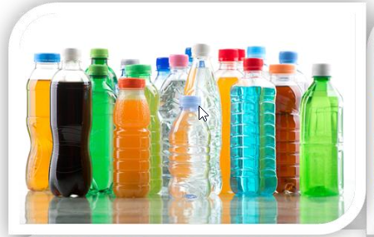
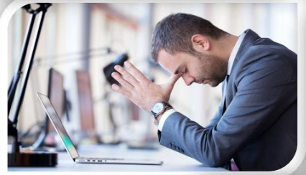
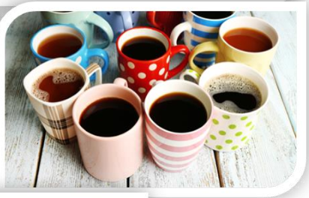
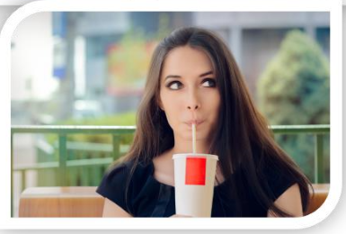
AT WORK OCCASION - FACTSHEETS
SIZE
CONSUMERS
At Work is one of the biggest occasion/drinking moment in terms of expenditure
19,4 BN Euro size of the occasion
13,2 % of all occasion in volume
2,6 BN Euro size of the prize
TCC share within the occasion 11,5%
8 to 10 glasses of fluid every day to be properly hydrated
70% of consumers feel it is very important to stay hydrated
Only 40 % of men and 60 % of women are properly hydrated
Almost 50% of consumers are not currently satisfied with beverage choice in the workplace
Motivation: energize, harmony, unwind
Sub –occasions: 58% while working, 31% while taking a break, 11% while eating
When: 8 AM to 8 PM, 86,1% of occasion value
At Work occasion generates the highest value between 11am & 5pm
L
CATEGORIES
CHANNELS
Coffee is the biggest category – 43,6%
Water - 21,7% ,SSD – 14%, Tea – 7,9%
Juice - 6,2%, Diary & Soy – 4,4%
Energy drinks – 2%, Sport drinks – 0,2%
34% of people are looking for large packs to stay refreshed and hydrated
32% of people prefer smaller bottles and cans while taking a break and eating
80% beverages consumed at work are purchased outside of workplace
Companies: 50 -250; 250+
Blue collar – high SSD share, White collar – high water & coffee share
Channels: Organized trade (C&C&B2B) – 4,1%
On The Go & QSR – 2,5%
HORECA (close to working place) – 3,6%
Workplace channel – 2,7%
RTM: DSD, ISD, Full Service Wending, Rental business
Gatekeepers: Owner, Purchasing, HR
L
Localize content with country figures

Slide 3
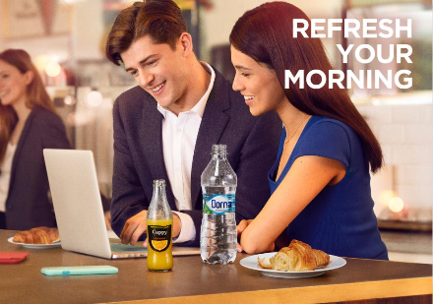
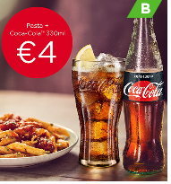
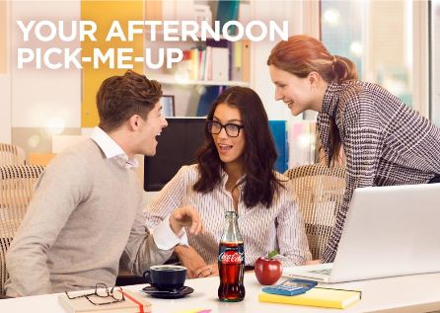
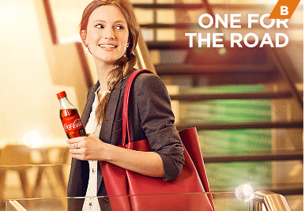
AT WORK ‘ON THE GO’ - FACTSHEETS
(outlet in proximity of 1-2 km from work place)
SIZE
CONSUMERS
1,3 % of TTL retail value within At Work drinking moments
9,7 % of retail value At work occasion
xx BN Euro size of the prize
TCC share within the subchannel xx %
Highest consumption volume during midday brake
L
CATEGORIES
CHANNELS
Coffee
Sparkling
Iced Tea
Water
Juice
80% beverages consumed at work are purchased outside of workplace
14 % At work occasion volume both in On The Go channels
L
Localize content with country figures

Slide 4
AT WORK ‘ON THE GO’ - SELLING STORY SUMMARY
(outlet in proximity of 1-2 km from work place)
1. IDENTIFY / SUMMARISE OPPORTUNITY
2. BIG IDEA
At Work is one of the biggest occasion in terms of expenditure
1,3%of TTL retail value within At Work drinking moments
9,7% of retail value At work occasion
xx BN Euro size of the price
TCC share within the subchannel xx %
80% of beverages consumed is outside the work place, majority
during midday brake
14 % At work occasion volume both in On The Go channels
Together, we can capture the additional revenue opportunities of “At work” occasion with FULL PORTFOLIO offer to your customers
ACHIEVE GROWTH:
YOU can capture this opportunity with xxx
increased transactions, €xxx incremental revenue and
€xxx Incremental cash margin, by listing our products, equipment and
promo offer to your consumers
3. HOW IT WORKS
4. KEY BENEFITS
Drive profitability through full portfolio availability
Combo offers and incentivized purchase drives transaction growth
COMBO MEAL DEAL
COMBO DRINK DEAL
WATER VISIBILITY
MULTI-PURCHASE OFFER
GIFT WITH PURCHASE
TIMED DEAL ON DRINKS RANGE
COMBO SNACK DEAL - PRIZE DRAW
Incremental Transactions and Revenue
Increased Cash Profit-Margin xx %
Increased Transaction xx % , € xx
Estimated Annual Profit Increase: €xx , + xx%
5. CLOSE
Summarise Key Points
Agree listings , promo offer and incentivized purchase with date of activation
Listen, Wait & Close!
Compete the Order

Slide 5
v
FULL SELLING STORY
On The Go (Kiosk & Gas Station)

Slide 6
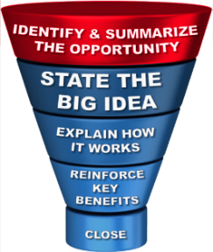
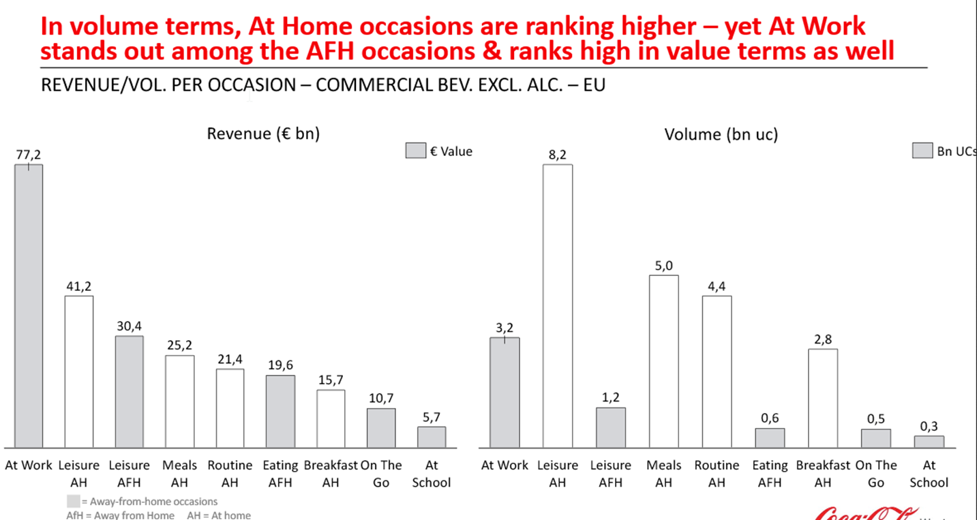
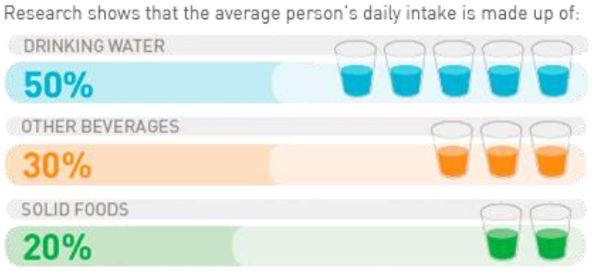
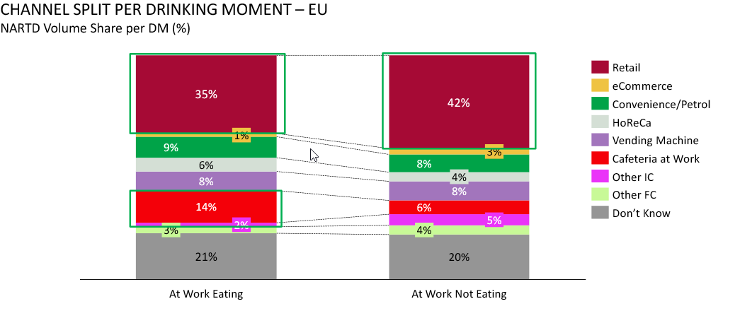
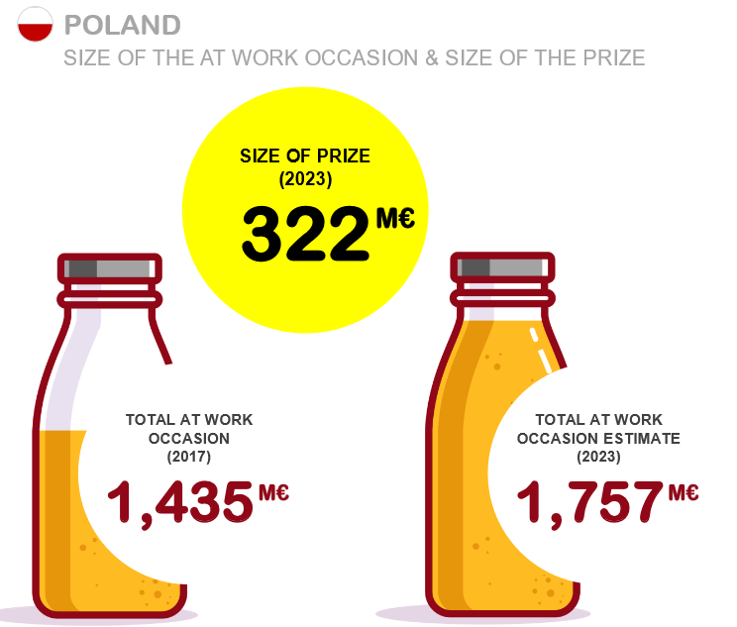
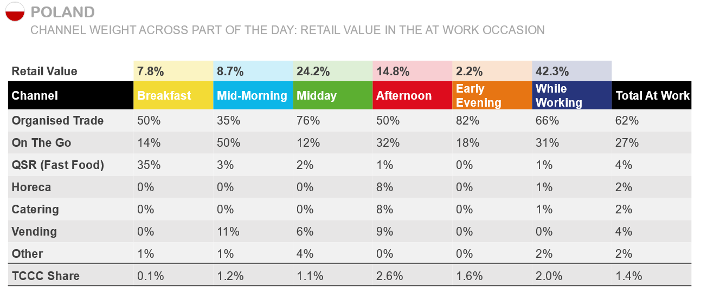
AT WORK OPPORTUNITIES
AT WORK IS THE BIGGEST REVENUE OPPORTUNITY
DEHYDRATION CAN INFLUENCE PHYSICAL & MENTAL PERFORMANCE
L
MOST OF BEVERAGES ARE BOUGHT OUTSIDE THE WORKPLACE
SIZE OF THE PRIZE
L
Localize content with country figures

Slide 7
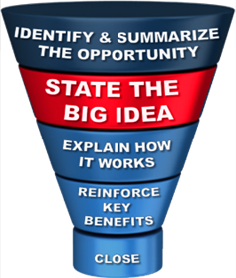
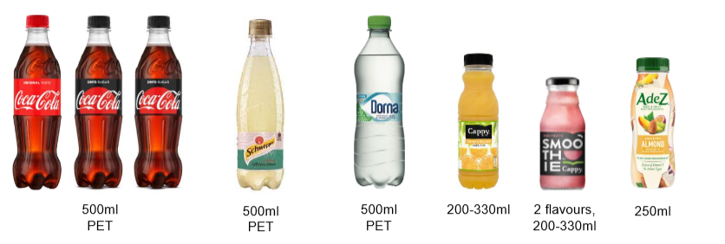
THE BIG IDEA
Drive incidence by leveraging full portfolio
focusing on outlets in proximity to work place
Examples:
With our assortment presence we will drive consumer consumption which will increase your profit for xx% and bring you XX Euro annually
By introducing water in your offer you can increase your sold volume for x% and revenue for x% annually
By introducing combo drink deal you can increase spend per head which will drive transaction growth for xx% and annual profit growth of XX Euro
L
L
Localize content with country SKUs and activation examples

Slide 8
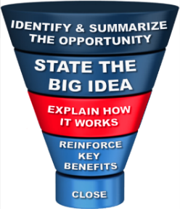
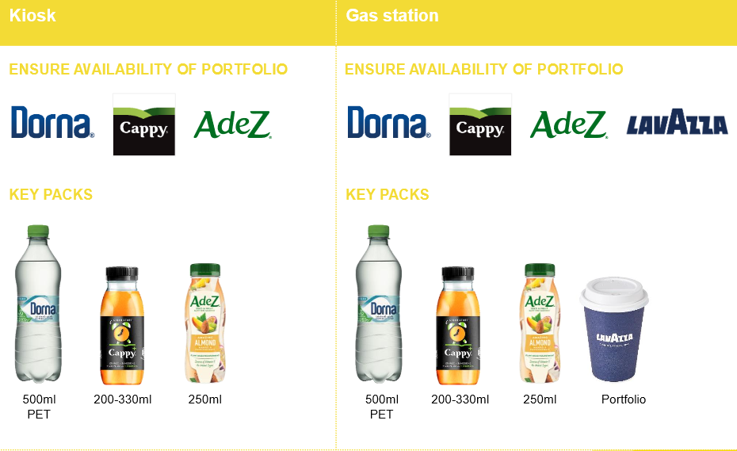
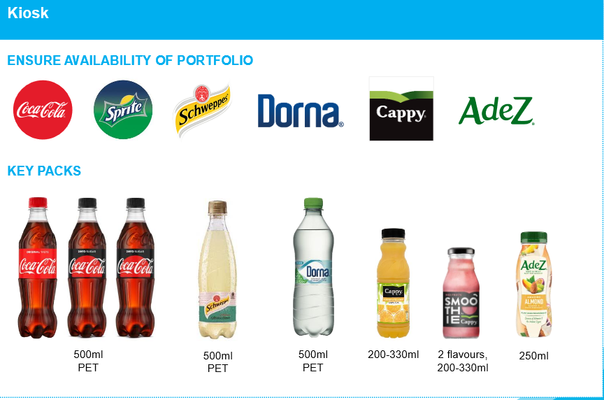
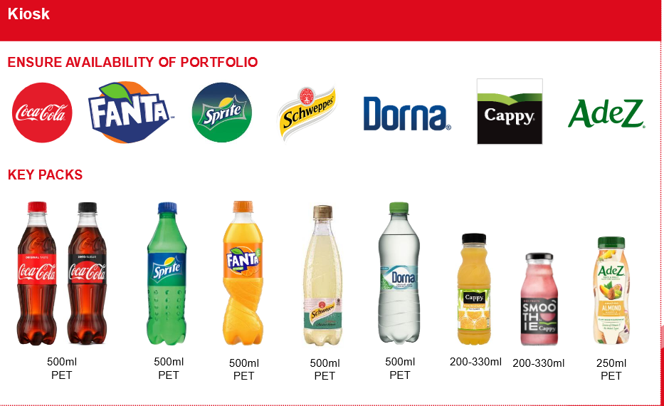
THE BIG IDEA
Right portfolio choice (categories & flavors) will cover different needs throughout the day and will drive traffic, incremental transactions & revenues
L
Start of day
Mid morning brake
Mid afternoon brake
L
Localize content based on country portfolio

Slide 9
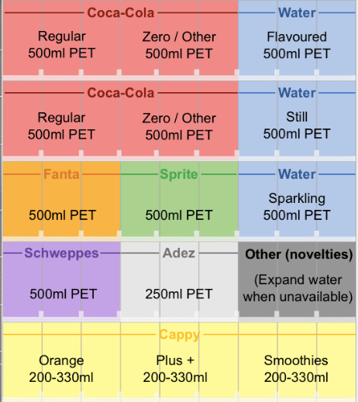
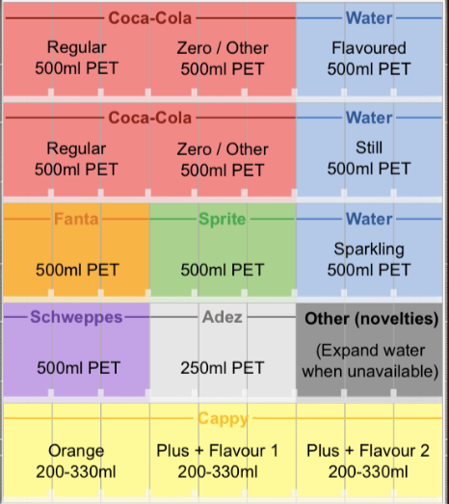
HOW IT WORKS – RIGHT ACTIVATION & EQUIPMENT
Kiosk Merch. standards
Gas Station Merch. standards
Markets should develop their own merchandising standards based on opportunities in the market and customer specifics, always with the objective to offer enough choice to consumers
L
L
Localize content based on country portfolio

Slide 10
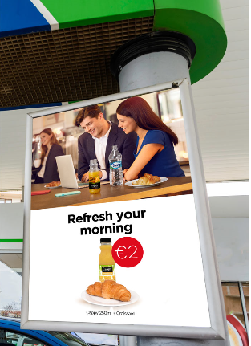
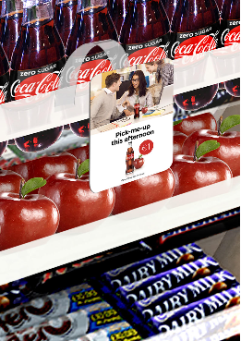
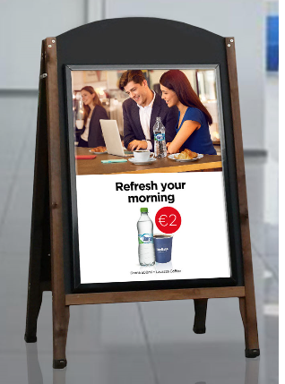
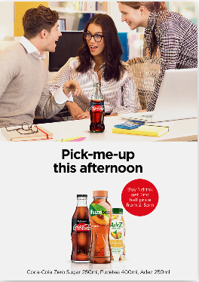
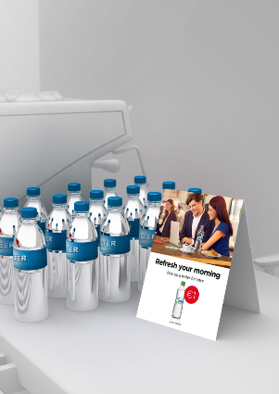
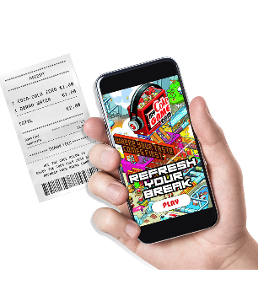
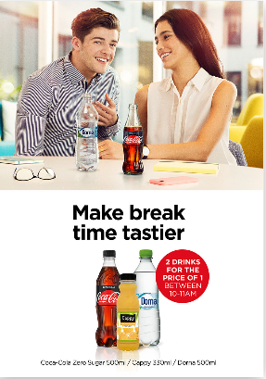
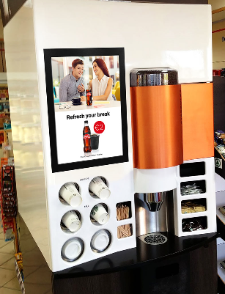
HOW IT WORKS – PROMO OFFERS
Examples throughout the day
COMBO MEAL DEAL Drink with breakfast item for set price
Benefit: Drives association of food and drink
PRIZE DRAW Scan receipt for a chance to win prizes in daily draw. Image recognition capabilities verifies validity of OTG retailer and drink. Prizes themed around breaks: free Adez / magazine subscription / weekend away / holiday
Benefit: Incentivizes purchase and associates drink with taking a break
COMBO DRINK DEAL Hot drink with chilled drink for set price to encourage ‘one for now, one for later
Benefit: Greater spend per head
COMBO SNACK DEAL Snack and drink combo for set price
Benefit: Convenience and value drives purchase of drinks with snacks
TIMED DEAL ON DRINKS RANGE Buy 1 drink, get second half price between 14.00-17.00
Benefit: Increased incidence at set time of day
WATER VISIBILITY Ambient water display by coffee machine or till as reminder to pick up a water for later
Benefit: Drives impulse purchase
COMBO MEAL DEAL Coffee with chilled drink for set price to encourage 'one for now, one for later
Benefit: Encourages trade up from possible free of charge offering on site
GIFT WITH PURCHASE Purchasing a drink prints
a code on the receipt to download a mini game which only lasts 15mins. Additional codes make the game more challenging
Benefit: Drives repeat purchase and association of drinks with break
MULTI-PURCHASE OFFER 2 for 1 / 3 for 2 offer on drinks purchased between 10:00-11:00
Benefit: Drives incidence of priority categories

Slide 11
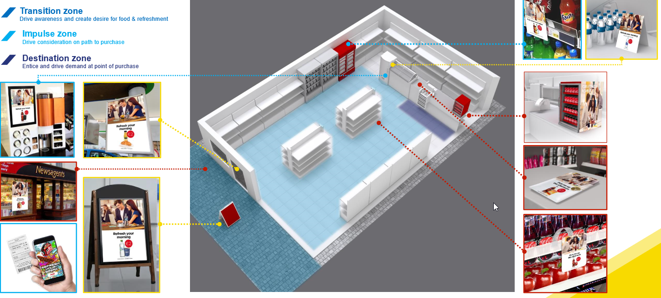
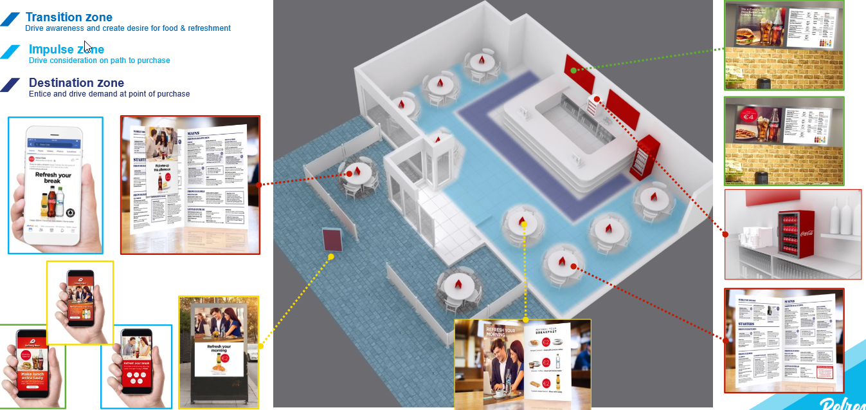
HOW IT WORKS – OPTIMUM PLACEMENT
START OF THE DAY
MID MORNING BRAKE

Slide 12
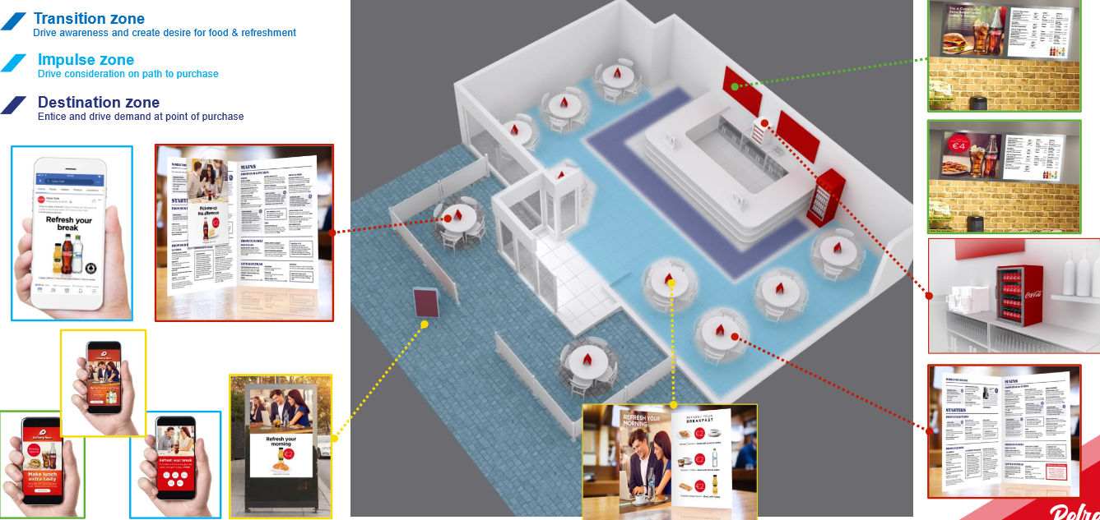
HOW IT WORKS – OPTIMUM PLACEMENT
MID AFTERNOON BRAKE

Slide 13
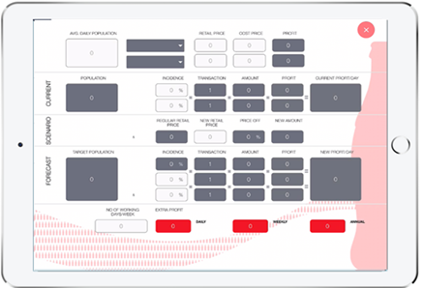
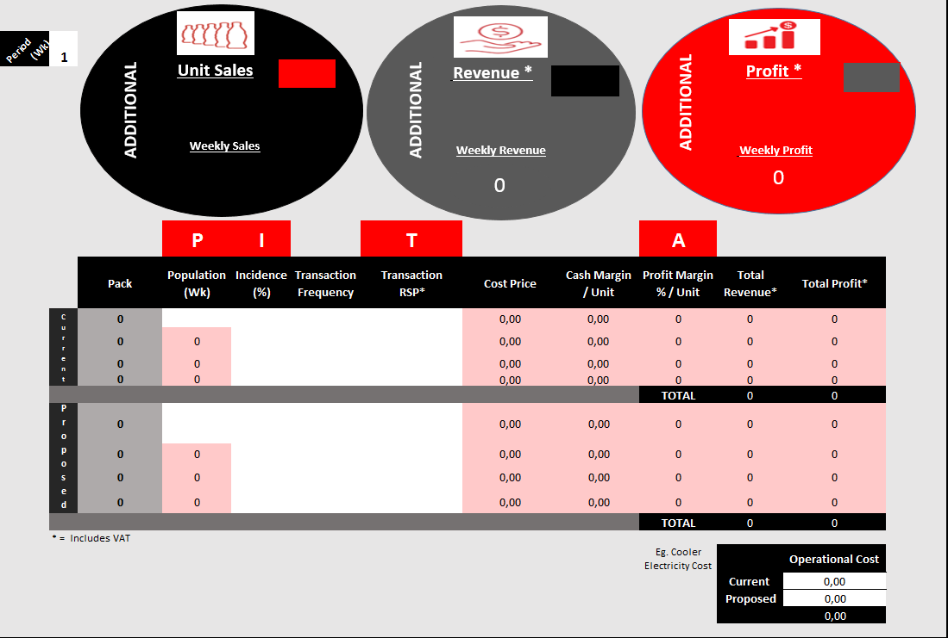
HOW IT WORKS – PROFIT STORY
Leverage profit story tool to show the customer the profit opportunity by: - Assortment listing - Combo drink deal - Incentivized purchase

Slide 14
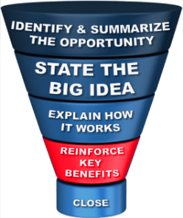
REINFORCE KEY BENEFITS
ASSORTMENT:
Share of profitable categories (SSD, Coffee, Juices) will increase annual profit by XX Euro
Increase transactions by XX%
PROMO OFFERS :
Increase Annual Profits by, potentially XX € , XX%
INCENTIVIZED PURCHASE:
Increase Annual Profits by, potentially XX € , XX%

Slide 15
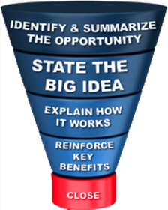
CLOSE THE DEAL
When we will sign the contract
When we will deliver the cooler in the outlet
What/when the order will be place
When we will activate the promo offer

Slide 16
CLOSE THE DEAL

Slide 17
Thank You

